Slide 1
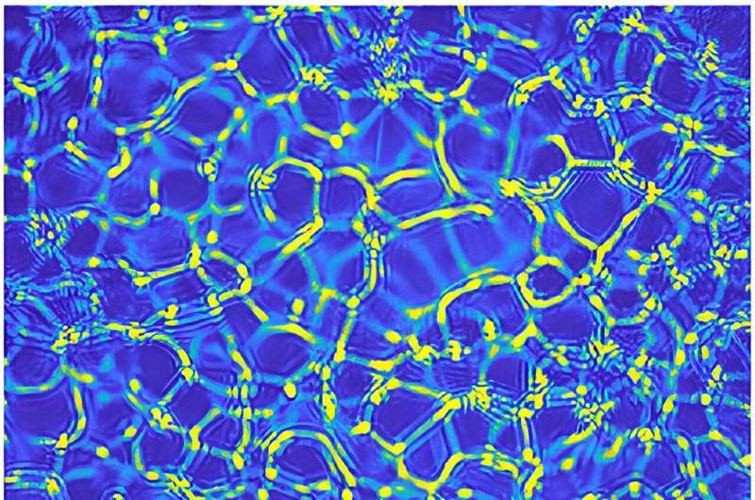
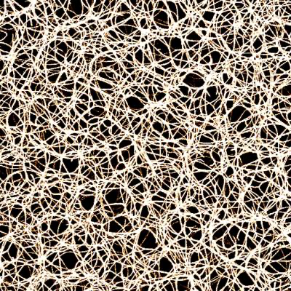
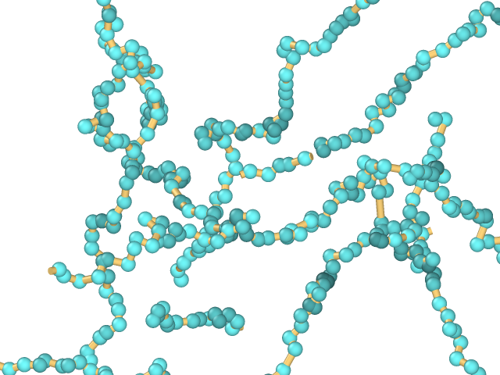
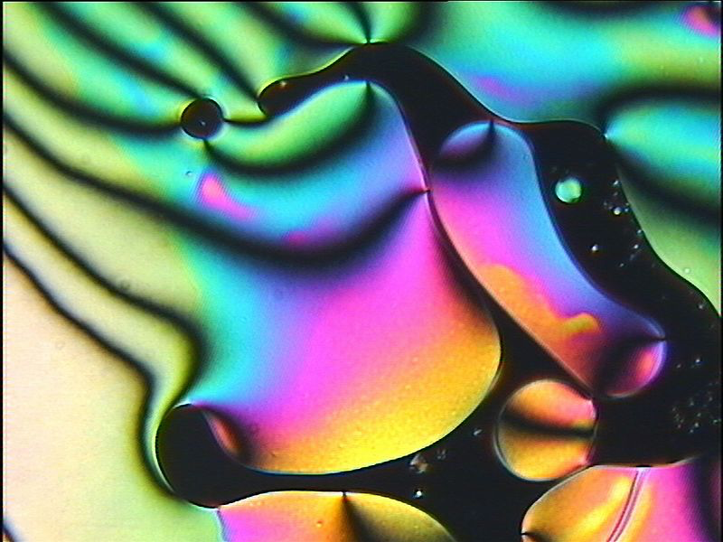
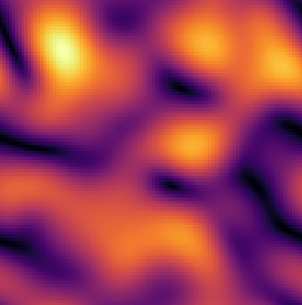
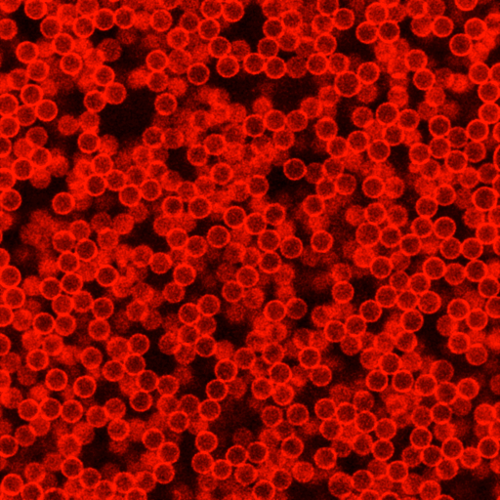
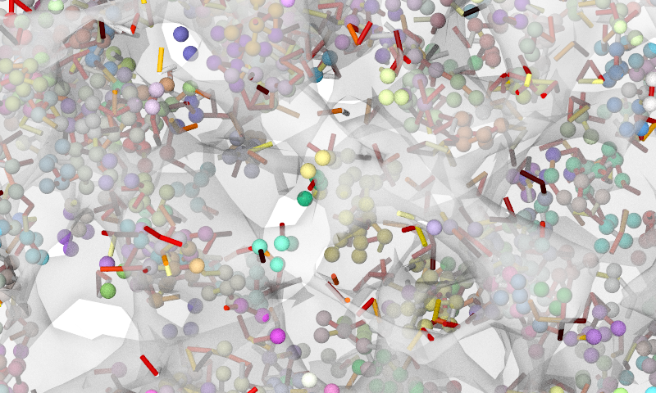
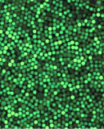
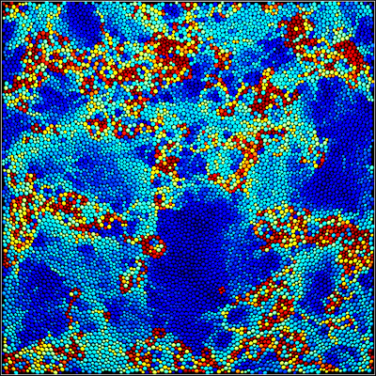
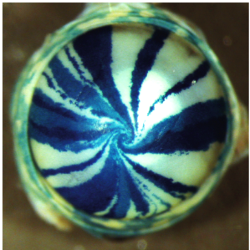
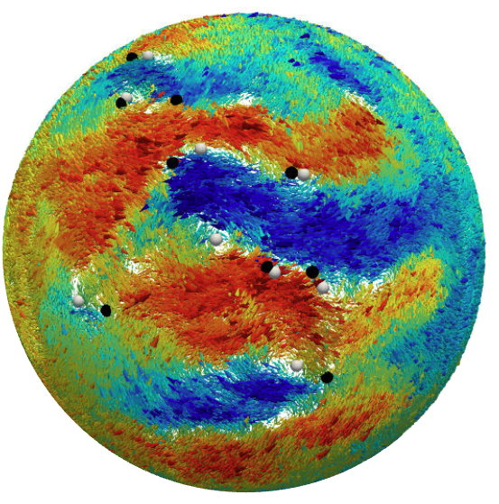
COMPLEX DISORDERED MATTER
Complex fluids
Polymers
Liquid crystals
Instability in a fluid of nanoparticles and models of complex mixtures
Actin polymer network (bone) and molecular dynamics polymer simulation
Nematic liquid crystals and continuum modelling of the nematic order parameter
Gels
Glasses
Living tissues
Emulsion gel at the confocal and force chains in its coarse-grained model
Confocal image of a colloidal glass and emerging dynamical heterogeneities
Spiral corneal striping (mouse) and its study with active matter

Slide 2
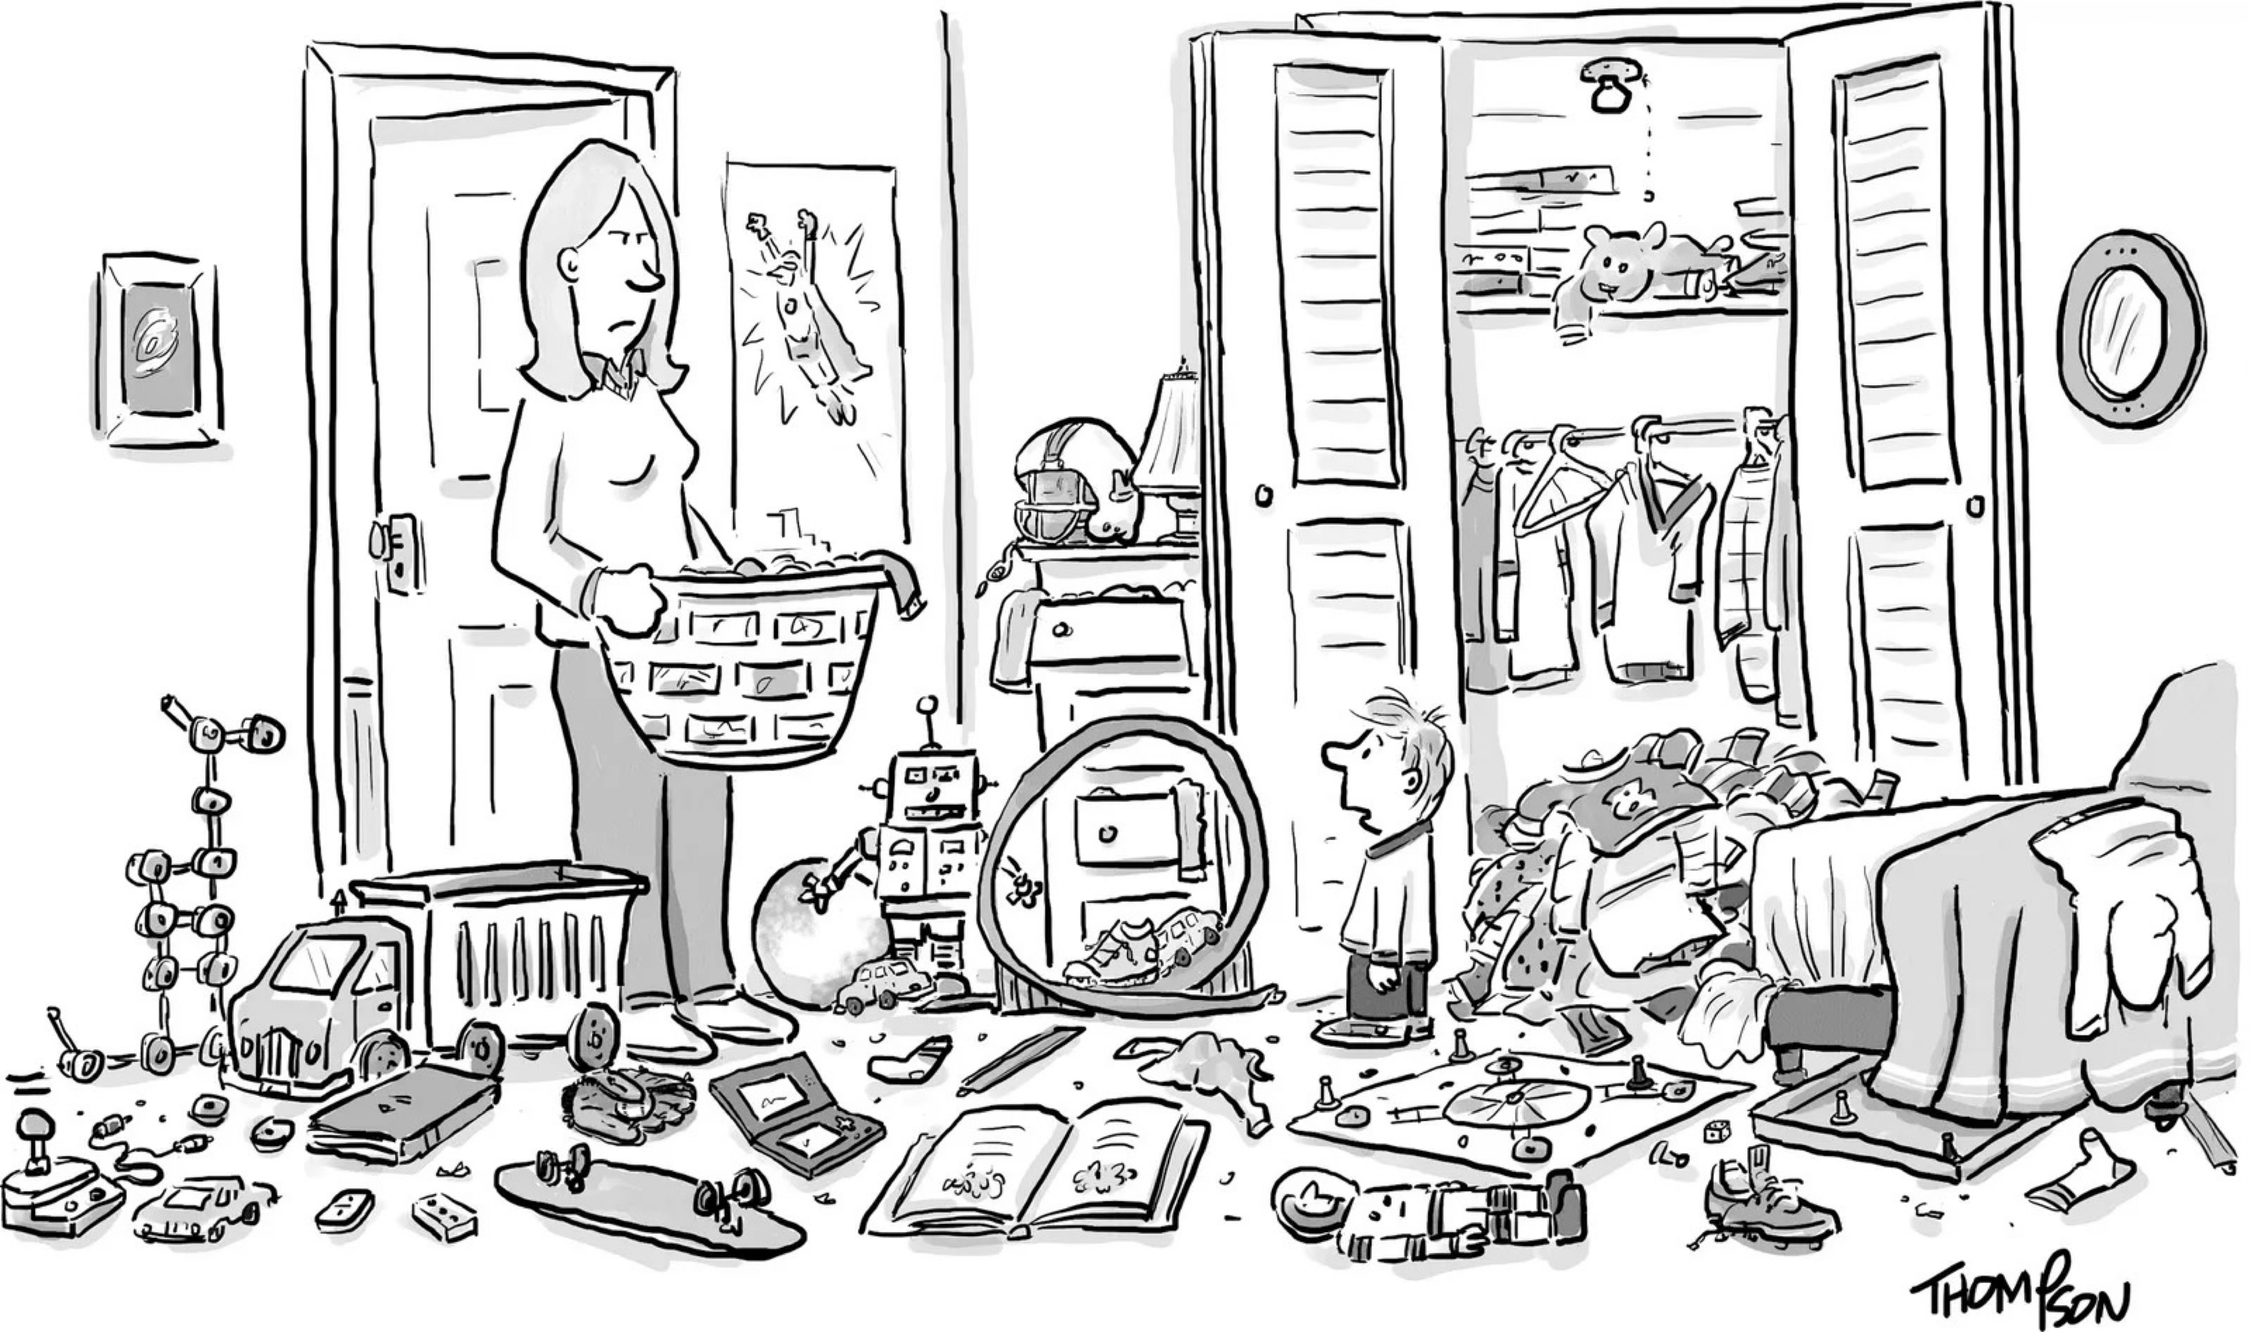
“I blame entropy.”
Credit: Mark Thompson / The New Yorker Collection

Slide 3
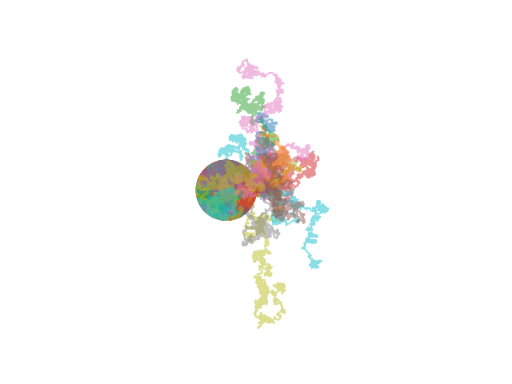
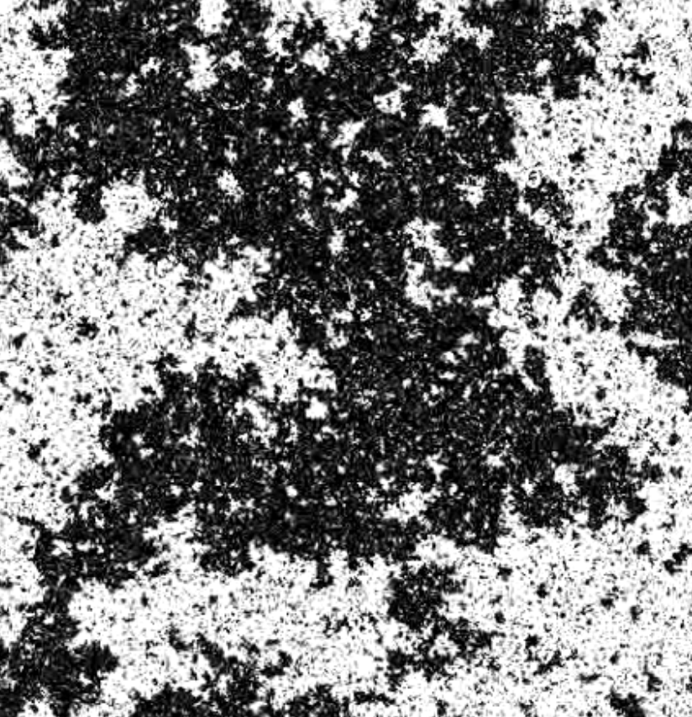
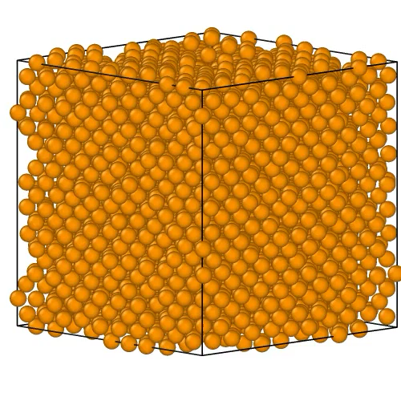
Unifying concepts
ENTROPY
Stochastic Dynamics
Phase Transitions
Disorder & Frustration
Critical Phenomena
Random walks Langevin equation Stochastic calculus
Landau theory
Metastability Scattering techniques
Energy landscapes
Configurational entropy
Calorimetry
Scaling
Renormalisation group Universality
EQ AND NONEQ STAT MECH
Notes:
FT: I give a second attempt at this

Slide 4
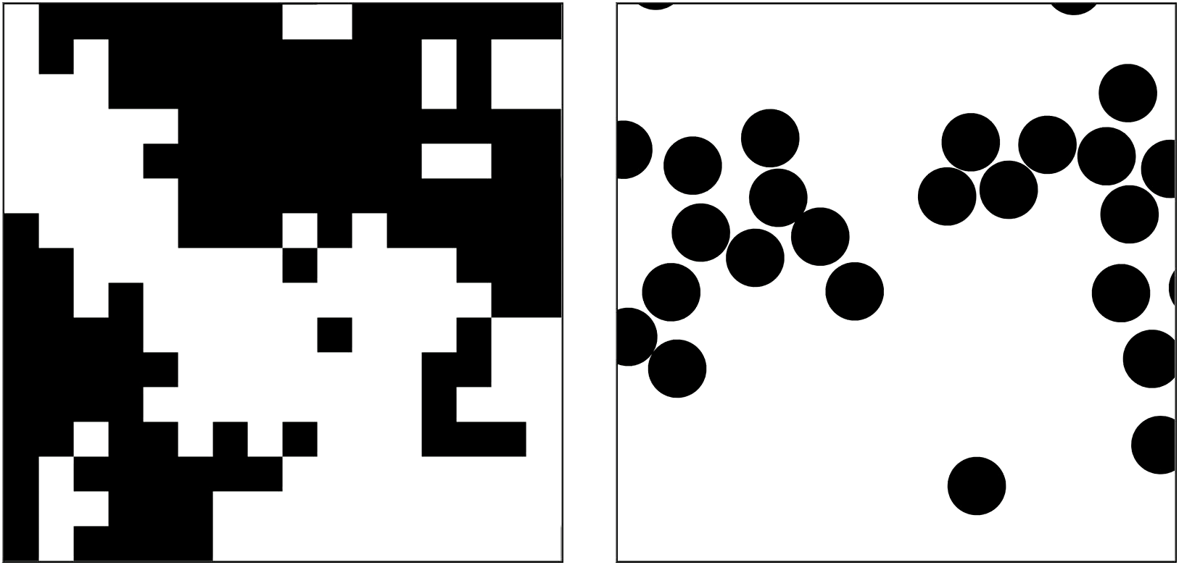
A closer look at universality
Magnet
Fluid

Slide 5
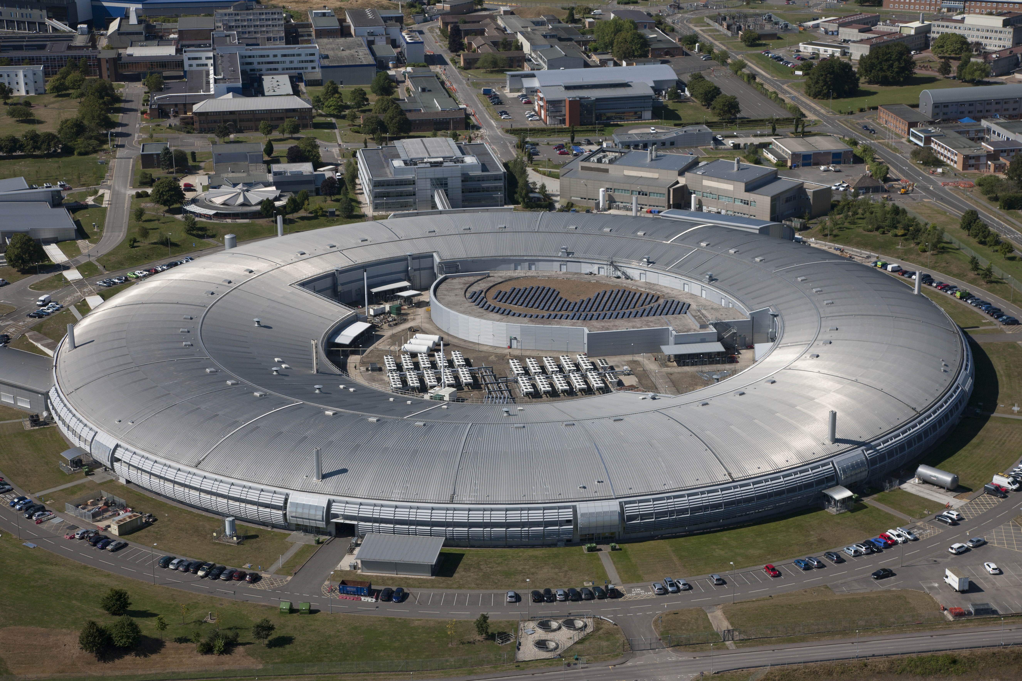
📚 Course Structure
🎓 Teaching Block One (September - December)
- 20 Credits | 3 Lectures per week + Problem Class
📌 Unifying Concepts & Theoretical Techniques (Lecturer: Nigel Wilding)
- Statistical Mechanics & the role of entropy
- Phase Transitions
- Metastability & Dynamics
- Critical Phenomena
- Scaling, Universality & Renormalization
🧩 Complex Disordered Systems (Lecturer: Francesco Turci)
- Colloids & Self-Assembly
- Polymers & Surfactants
- Liquid Crystals, Gels, Glasses
- Active Matter
🔬 Experimental Systems & Techniques (Lecturer: Adrian Barnes)
- Calorimetry
- Microscopy
- Diffraction
✨ + Planned Visit to the Diamond Light Source!

Slide 6
What Will You Gain?
🔬 Explore the fascinating Physics behind real-world systems. From liquid crystals and polymers to gels and active matter.
🎯 Master Powerful Methods
Understand how microscopic interactions shape the macroscopic world
Learn concepts and techniques that find application in finance, geophysics, AI, neuroscience, and more
🔥 Boost Your Skill Set!
✅ Mathematical tools
✅ Problem-Solving
✅ Computational methods
✅ Effective Communication
✅ Teamwork & Collaboration

Slide 7
📊 Assessment Breakdown
🖥️ Computational investigations - 2 Assignments (25% each)
📖 Final Exam – Covering all lecture material (50%)
📌 Total: 100% Assessment – Equally balanced between coursework and final examination.

